Slide 1
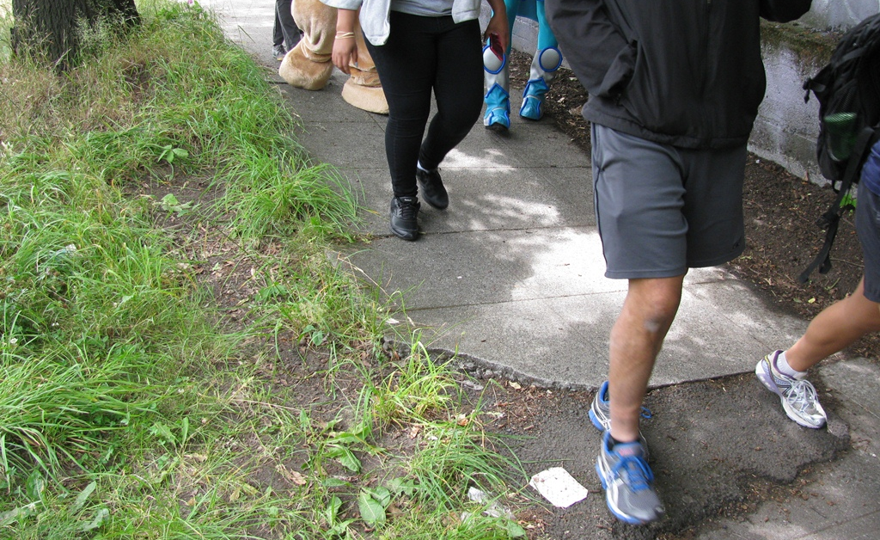

Accessible Mt. Baker Integrated Multimodal Plan
Seattle Planning Commission
Michael James, SDOT
January 8, 2015

Slide 2
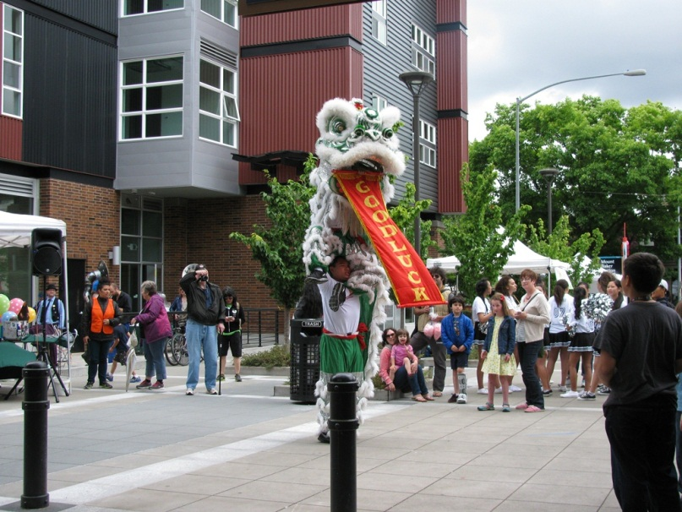
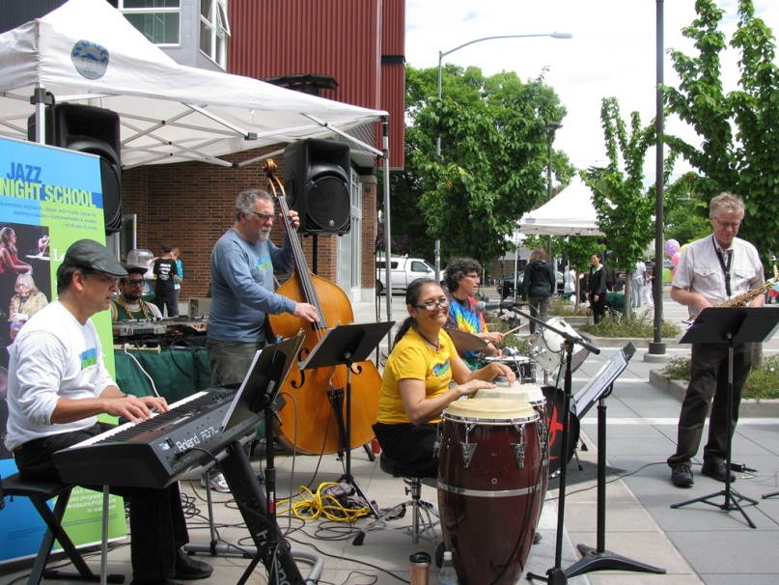
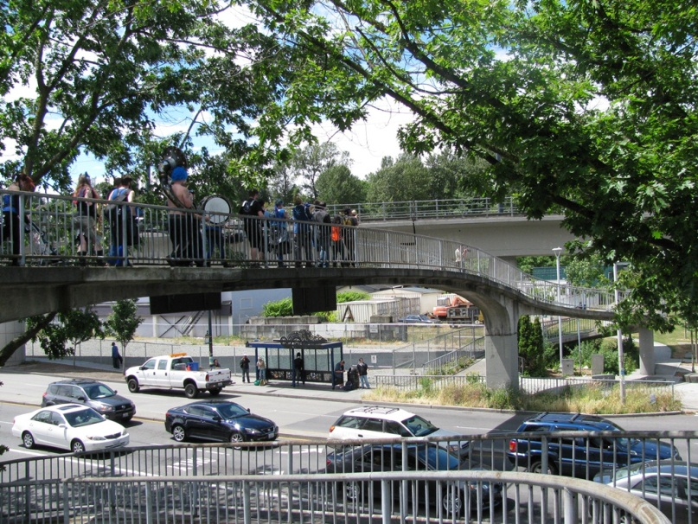
SDOT’s mission & vision
Mission: delivering a first-rate transportation system for Seattle.
Vision: a vibrant Seattle with connected people, places, and products.
2

Slide 3
SDOT’s core principles
Keep it safe
Focus on the basics
Build healthy communities
Support a thriving economy
Provide great service
3

Slide 4
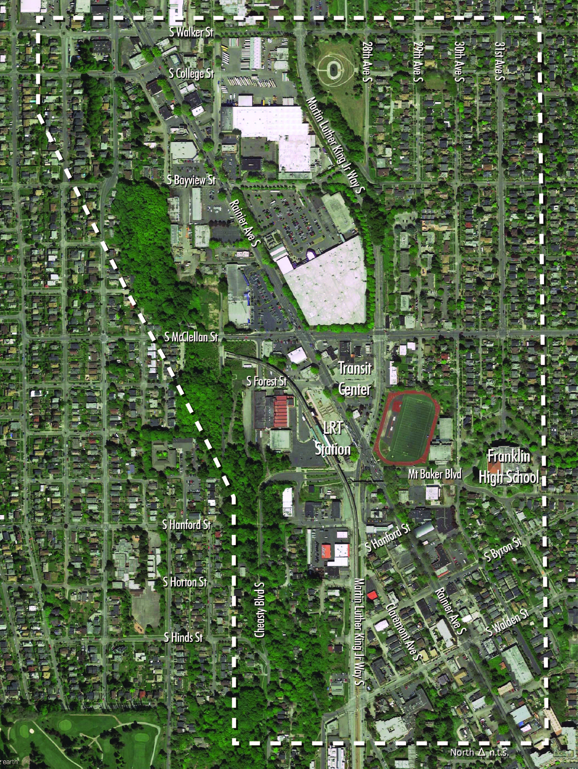
Background / Study Area
North Rainier Neighborhood Plan
SE Transportation Study
McClellan Town Center Development Strategy
North Rainier Action Plan
Seattle Station Area Transportation Analysis
Mt. Baker Urban Design Framework
Seattle Mobility Plans
Community Voices
North Rainier Neighborhood Plan
Southeast Transportation Study
McClellan Town Center Development Strategy
North Rainier Action Plan
Seattle Station Area Transportation Analysis
Mt. Baker Urban Design Framework
Seattle Mobility Plans
Community Voices
4

Slide 5
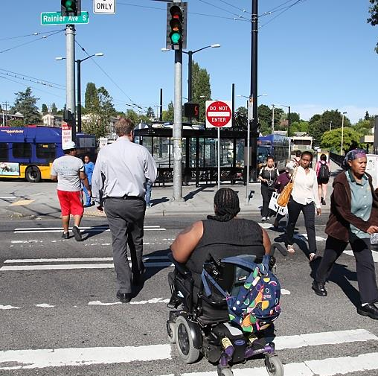
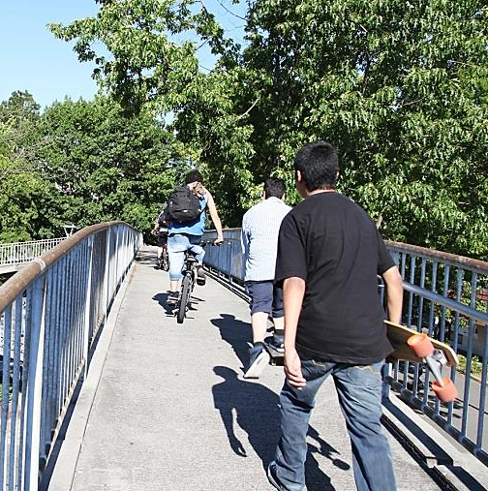
Teams
Interdepartmental City Team
Seattle Dept. of Transportation
Dept. of Planning and Development
Office of Housing
Dept. of Neighborhoods/Public Outreach and Engagement Liaisons
Somali, Spanish, Oromo, Tigrinya and Amharic
Consultant Team
HDR (transportation)
Cascadia Consulting Group (outreach)
5

Slide 6
Project outcomes
Identify and develop conceptual designs for pedestrian and bicycle safety improvements
Refine an integrated multimodal plan
Operational analysis for all modes
Reconsider the “Bowtie”
How are improvements prioritized and phased?
How can this strengthen community assets and values?
6

Slide 7
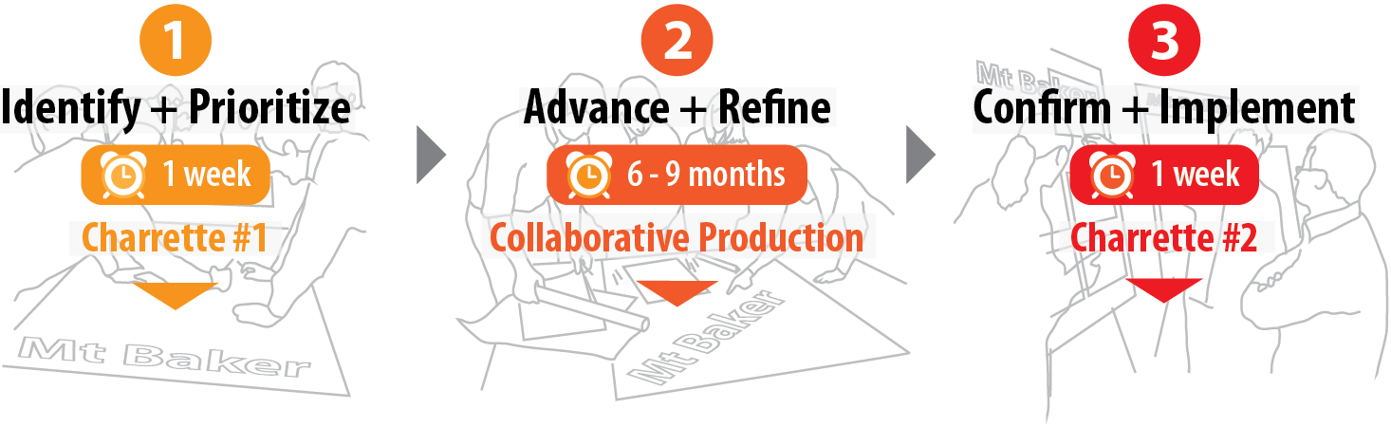
Scope Overview
Early public engagement
Public Event #1 (March)
Ongoing public engagement
Public Event #2 (June)
Results:
Identify short-term solutions; establish med and long-term priorities
Results:
Advance short-term projects and refine integrated multimodal plan
Results:
Deliver an integrated implementation plan to move improvements forward
7

Slide 8
The Charrette Week (Dec 15 – 19)
Town Center vision offered themes
Stakeholder interviews informed ideas
Project goal defined direction
Guiding principles framed fundamentals
Evaluation criteria helped test alternatives
Early concepts tested
New concepts prepared and evaluated
Long-term plan emerged
Near-term actions followed

Slide 9
Accessible Mt. Baker goal
Recognize Mt Baker is the gateway to southeast Seattle, with the intent of creating a place that honors the tradition of compact, walkable, and mixed use communities.
The outcome is a place where jobs are retained and created. The multi-modal plan prioritizes modes as: Pedestrian, Bicycle, Transit, Freight and Auto. Town Center Vision themes are incorporated. In doing so, Mt Baker becomes a “To Place” rather than a “Through Place”, making it a highly desirable destination.

Slide 10
Guiding Principles
Integrate transport and land use
Create a network of streets, paths and open space
Identify and respect known constraints
Make a legible and identifiable place
Establish the hierarchy of modes as:
Ped/Bike: Safety and comfort
Transit: Reliable and frequent
Freight: Access and geometrics
Auto: Calm and equal throughput
Optimize fire and emergency access
Apply universal design and promote equity

Slide 11
Long-term Concept
Reflects the prioritized modal preferences
Restores the traditional urban values
Eliminates the confluence of streets
Supports redevelopment to the north and conservation to the south
Allows the Olmsted Greenway extension
Creates the desired destination

Slide 12
Near-term actions
Phase 1
Pedestrian safety and comfort improvements
Other actions
Phase 2
Traffic and transit modifications
Mt Baker station enhancements
Pedestrian safety and comfort improvements
Bicycle safety and comfort improvements

Slide 13
Schedule
December 2014: launch study, Charrette #1
January – March: early engagement
March: public event #1
April – July: ongoing public engagement
June: public event #2
Fall 2015: final report
13

Slide 14




Questions?
michael.james2@seattle.gov | (206) 386-4012
http://www.seattle.gov/transportation

Slide 16
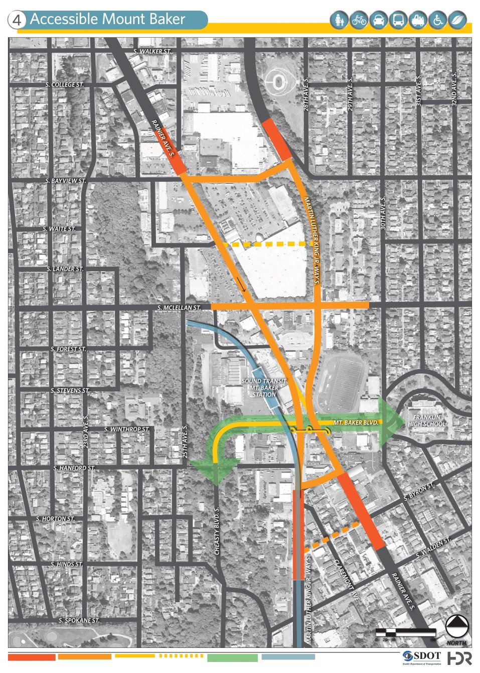
Early concepts reviewed

Slide 17
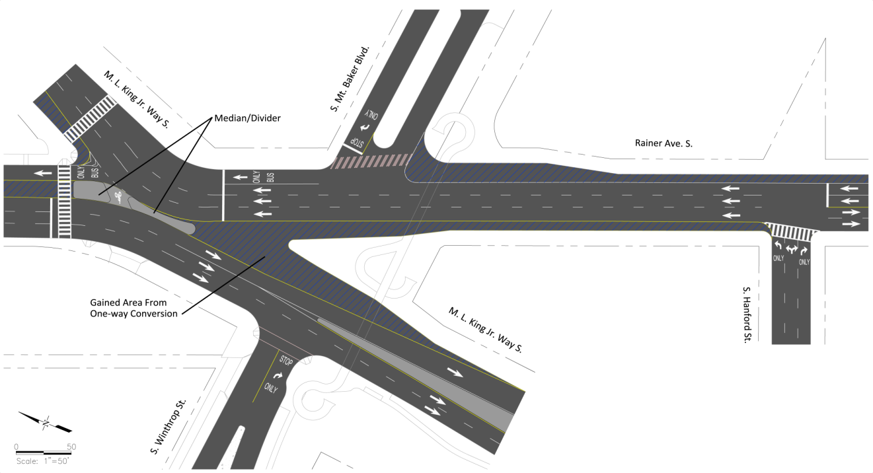
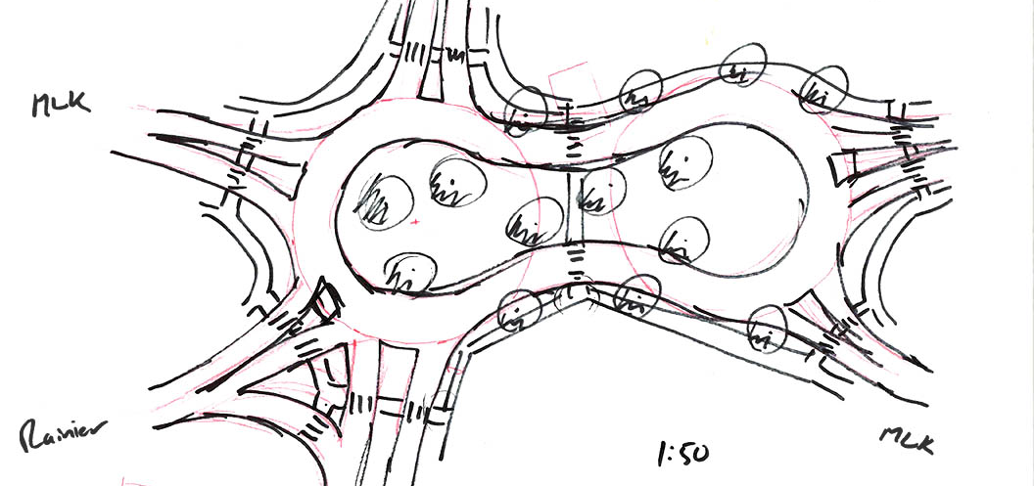
Early concepts reviewed
Bowtie
Roundabout
17

Slide 18
Stakeholder Interview Summaries
Pedestrians
Bikes
Transit – bus and light rail
Freight
Repurposing Rainier
Connectivity
Urban design/TOD
Economic development/ opportunity sites
Unintended consequences
Concept feedback
Short-term ideas
Long-term ideas
Other issues

Slide 19
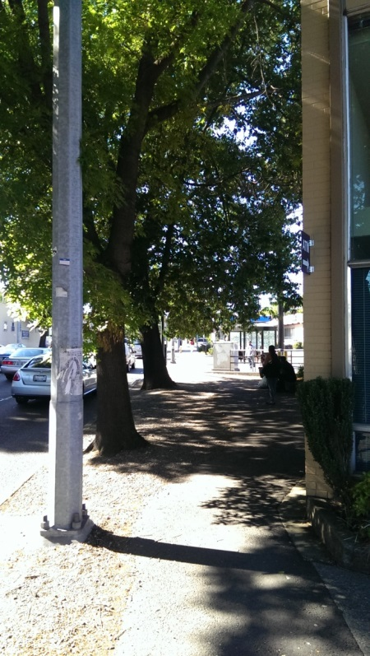
Evaluation Factors
In concert with the Guiding Principles, a set of Evaluation Factors was created to guide the overall multi-modal plan. These factors are for the prioritized modes as previously identified.
Pedestrian
Crossing distance
Conflict points
Traffic signal cycle length and walk distances
Eliminate push button pedestrian signals
Visibility
Large refuge areas

Slide 20
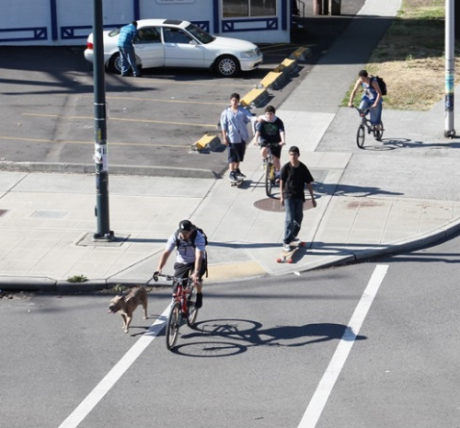
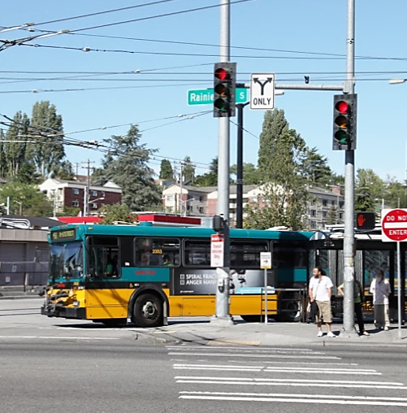
Evaluation Factors
Bicycle
Directness
Conflict minimization
Separation
Bike share
Parking
Transit
Reliability - schedule and frequency
Proximity and convenience
Rapid Ride-like features and amenities
Ease of transfer
Local transfer (bus to rail)
Regional transfer (rail to bus to rail)
On-street stops and layover

Slide 21
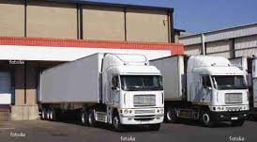
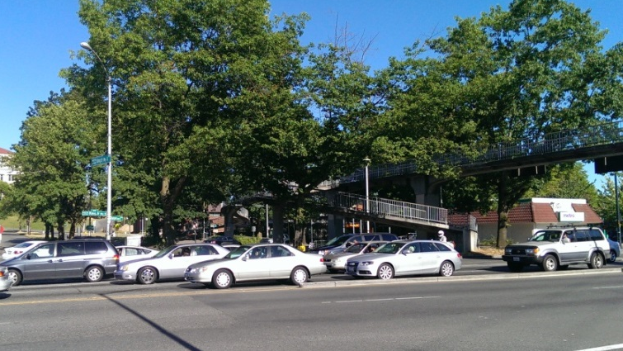
Evaluation Factors
Freight
Reliable trips for deliveries
Access to properties
Geometrics
Autos
Vehicles per lane
V/C ratio
% traffic diversion
Queue length
Travel times
Property and service access

